Slide 1
Colorization of black and white images
-Manav patel & rohan Kashuka

Slide 2
Introduction
Colorization today is done by hand using an image editing software.
This process is time consuming.
Neural net helps eliminate the manual labor and expedites the process.
The colors chosen are not necessarily correct but rather plausible.

Slide 3
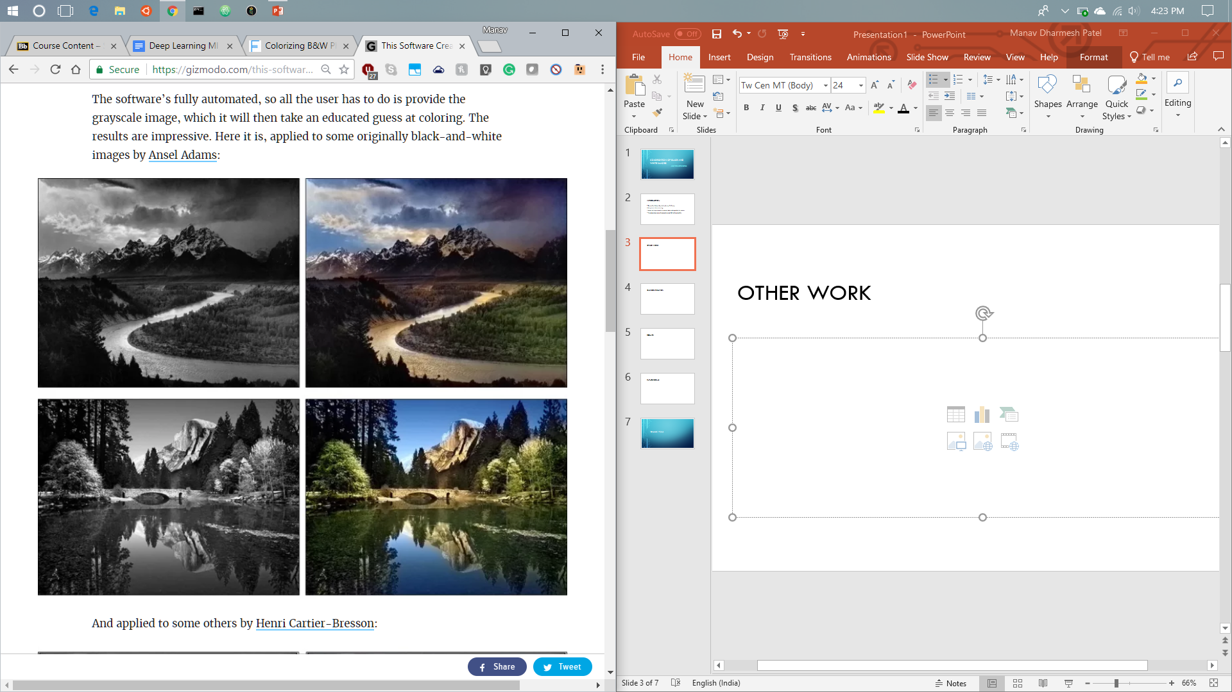
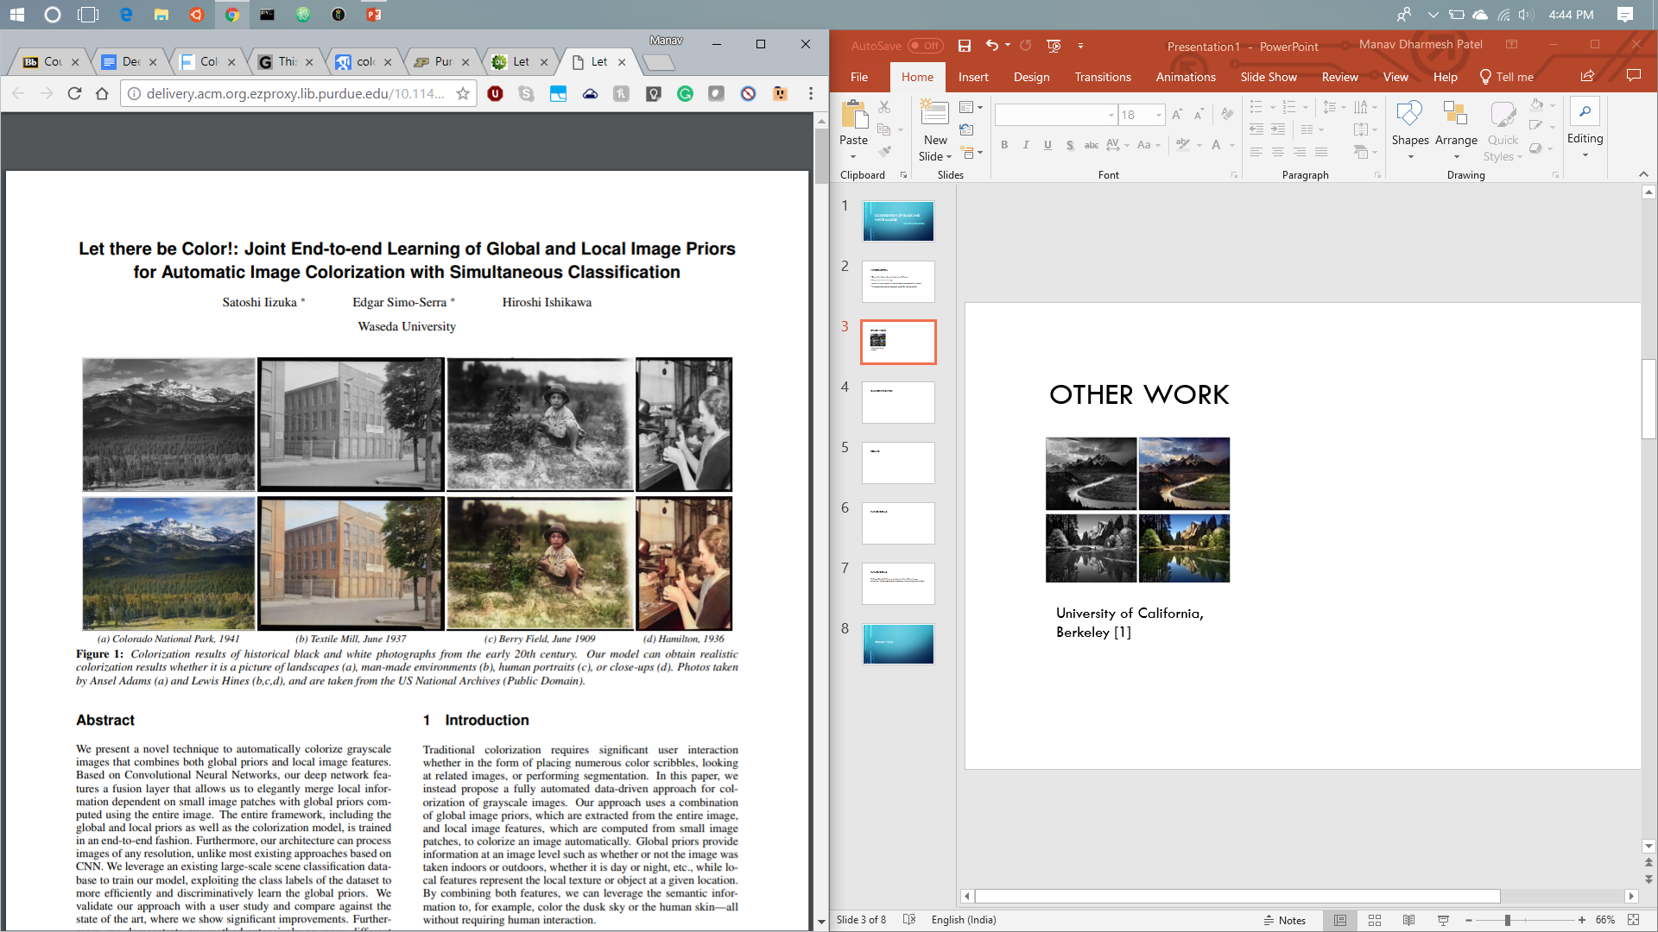
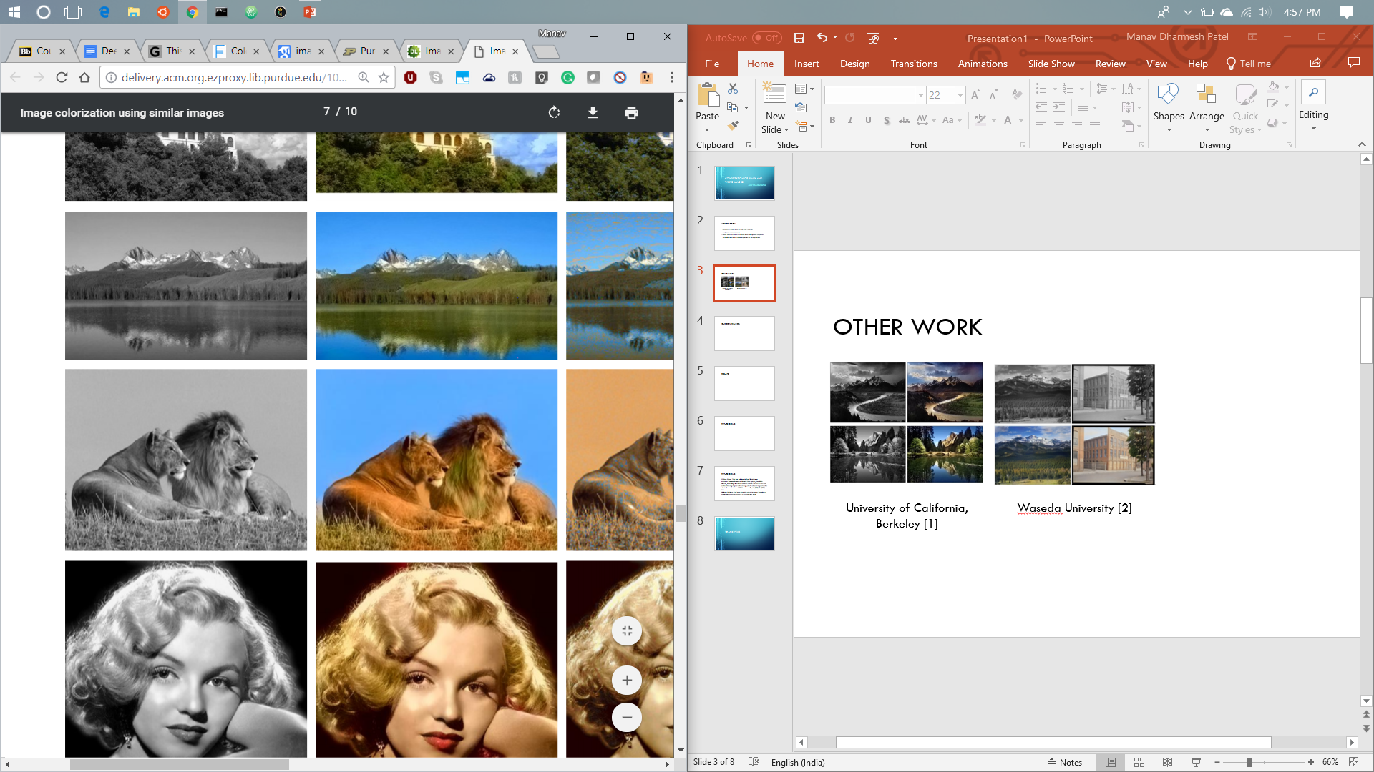
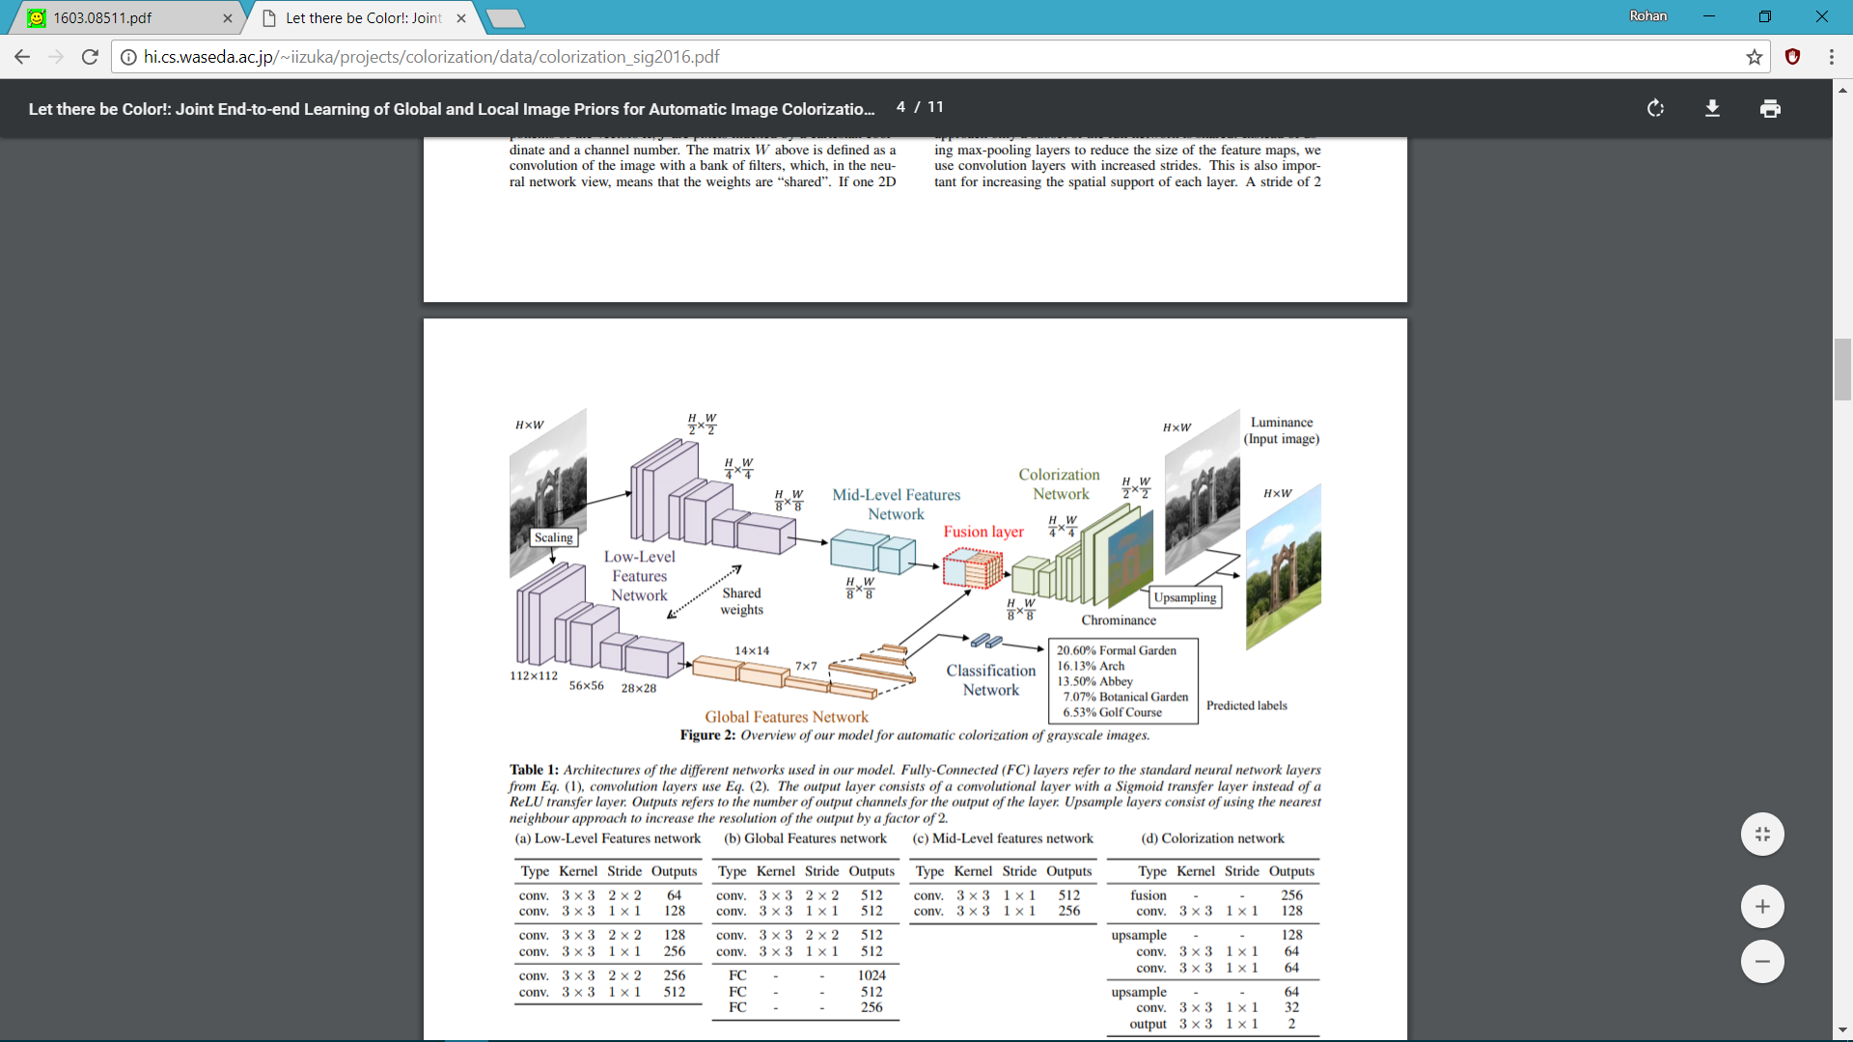
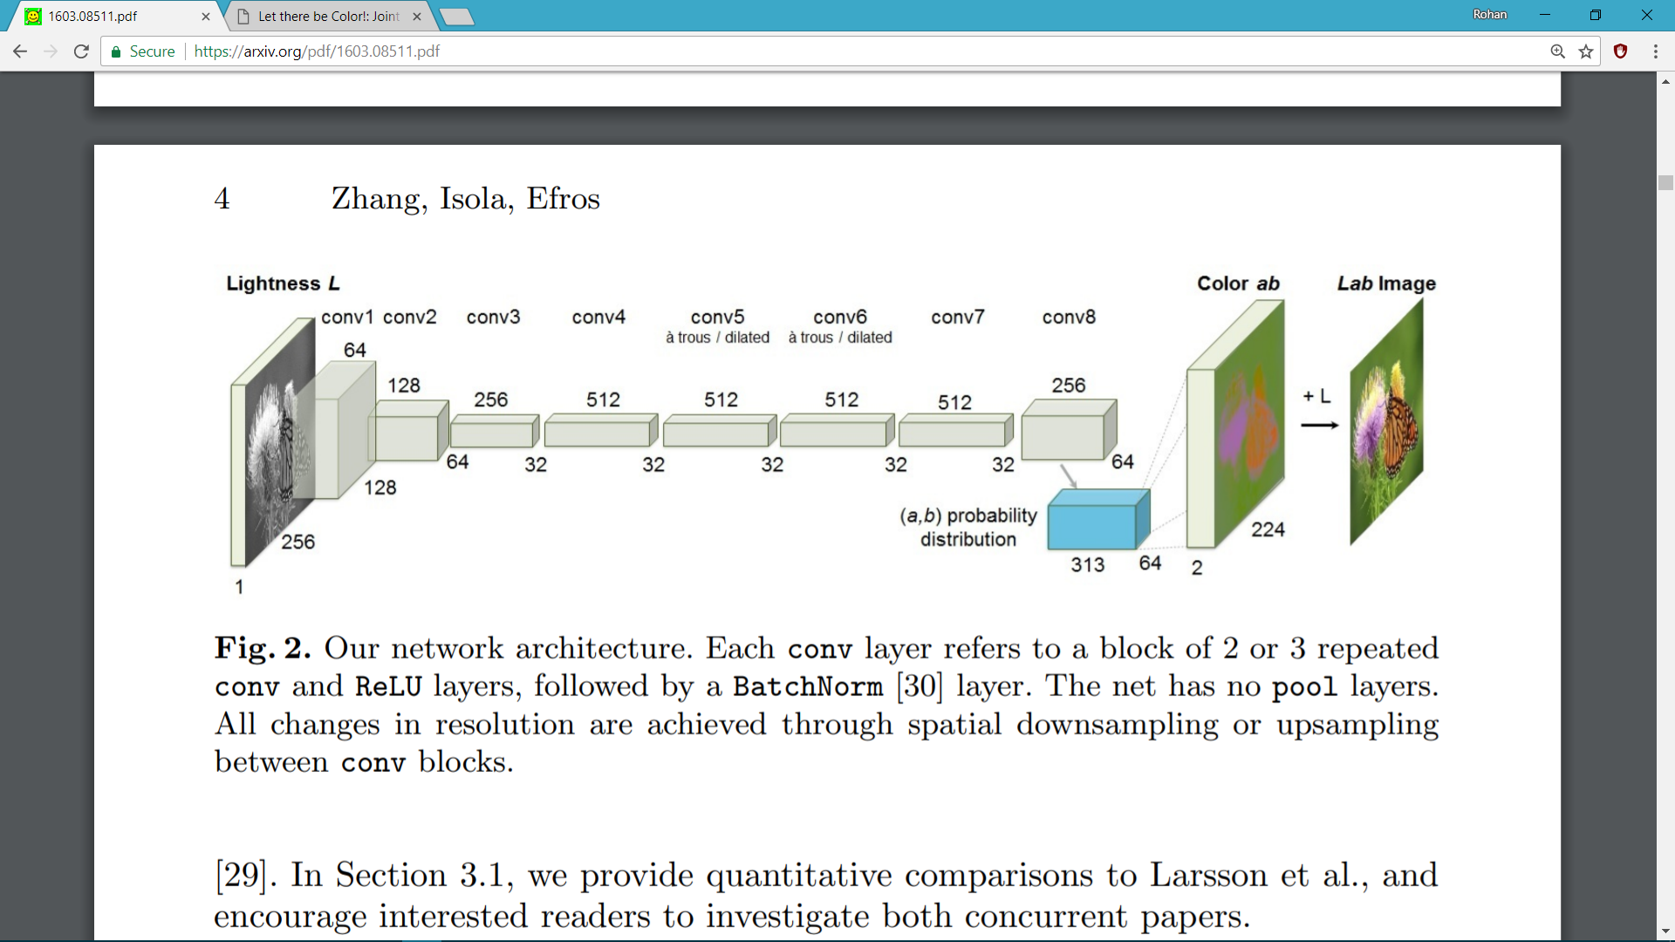
Other work
University of California, Berkeley [1]
Waseda University [2]
Nanyang Technological University [3]
Notes:
UC Berkley used convolution to down sample their image and then formulated a probability distribution which predicts the probability of the (alpha,beta) color-range based on the lightness values.
Waseda University used an two networks (1)encoder-decoder and a (2)classifier. They used fusion techniques to combine the encoded data from the 1st network and the convoluted features from the classifier. And then upsampled to get the output channels.
NTU used image similarity techniques to colorize images. No deep learning was used but we mention it because they had good results.
We did not try to recreate any of the existing papers but instead took ideas and inspiration. We came up with suitable network architecture based on trial and error.

Slide 4
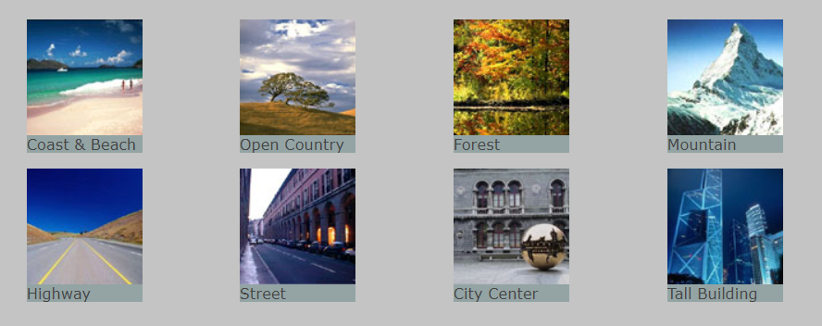
Dataset
Computational Visual Cognition Laboratory (MIT)
Approximately 1000 images
Notes:
Each image is 256*256

Slide 5
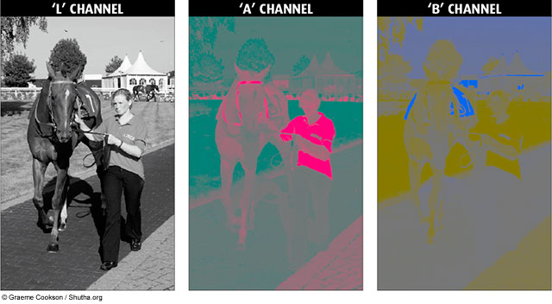
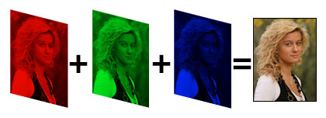
Our Network
LAB color space for prediction
Notes:
lightness and a and b for the color components green–red and blue–yellow

Slide 6
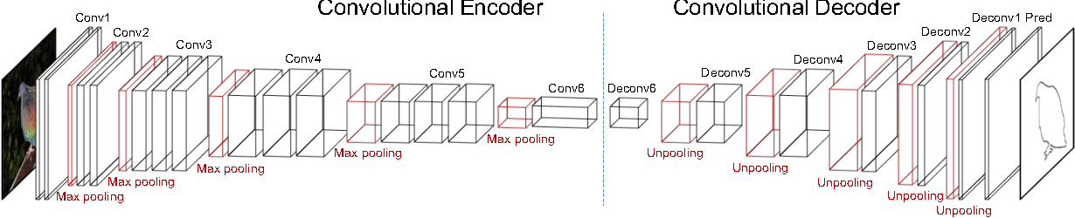
Our Network
Convolutional encoder decoder
Notes:
We tried maxpooling and 1*1 convolution with stride 2 for down sampling and found that the 1*1 convolution approach worked better.
The final network had 3 downsampling and 3 upsampling layers.

Slide 7
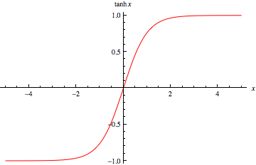
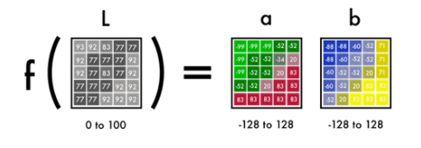
Our Network
RELU after every conv layer
Tanh for final activation
Notes:
We used tanh for final activation because the range is between (-1, 1). This plays well with the LAB color scheme as we only have the scale the predictions by 128 to get out final results.

Slide 8
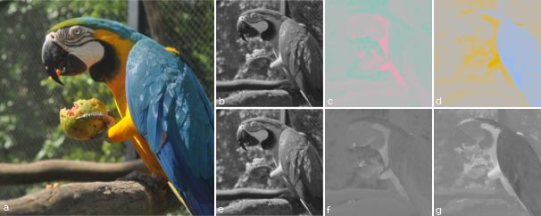
Our Network
1 input channel and 2 output channels are stacked in order to get final results
Network Output
Network Input

Slide 9
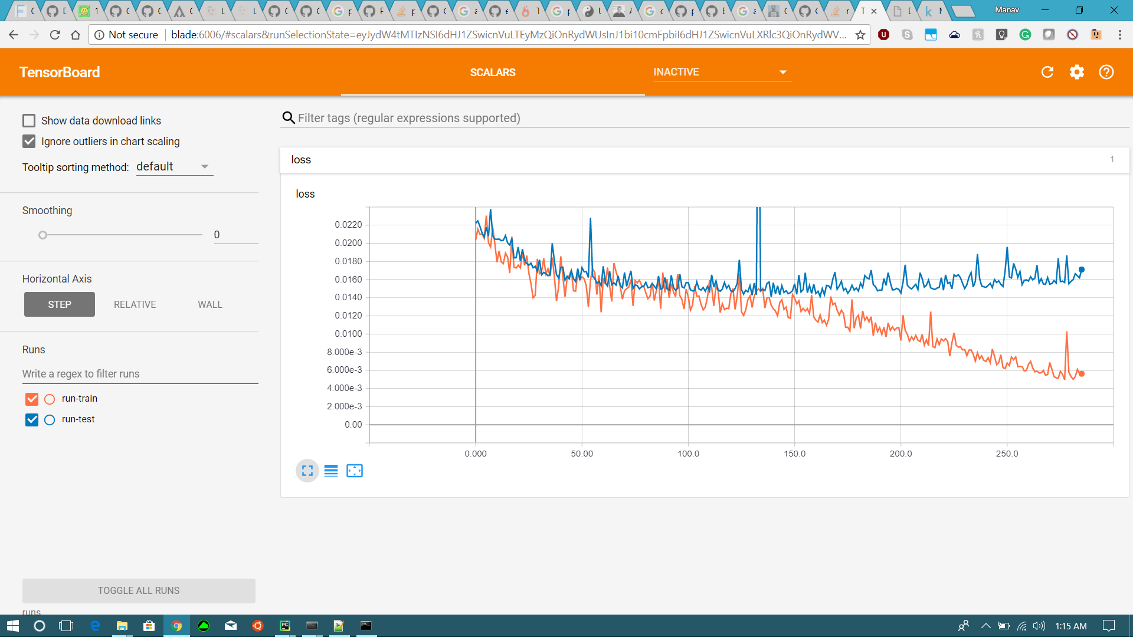
Results
Test
Loss
Train
Epochs

Slide 10
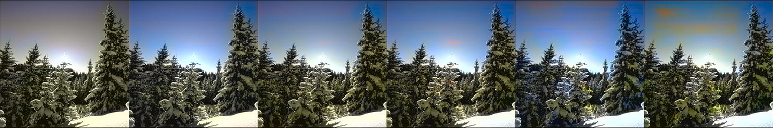
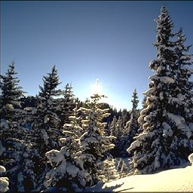
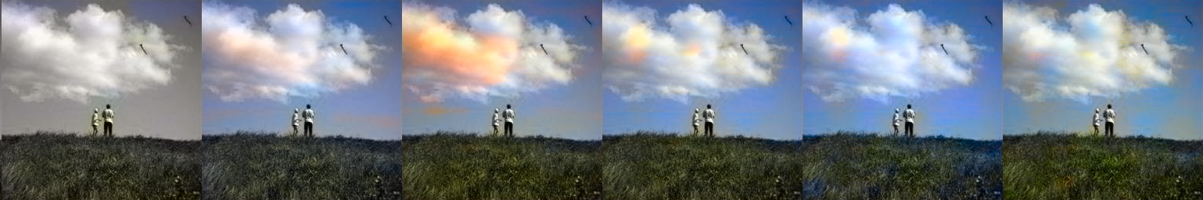
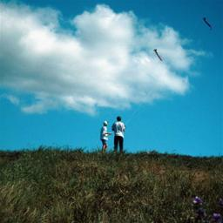
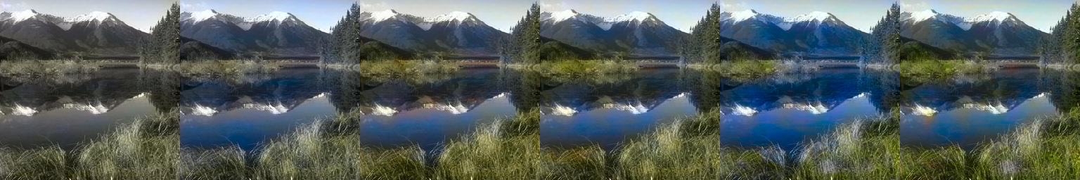
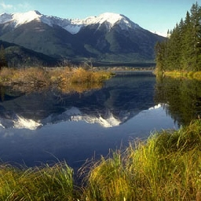
Good Results
Optimal Result
Ground Truth
50
100
150
200
250
275

Slide 11
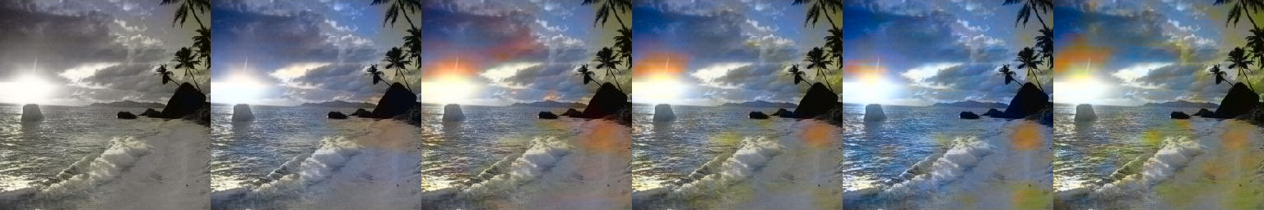
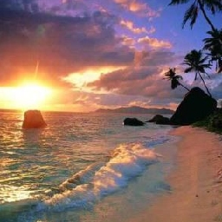
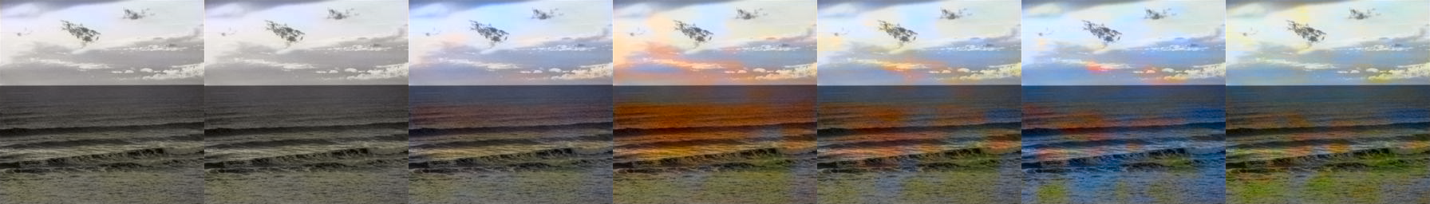
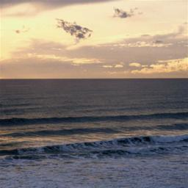
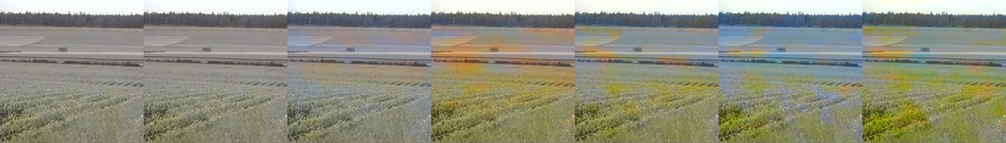
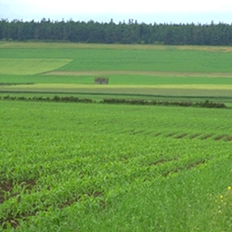
Bad Results
Optimal Result
Ground Truth
50
100
150
200
250
275

Slide 12
Future Goals
Add a classifier to the current model for better results.
Develop a Web Application that colorizes black and white images.
Work on colorization of black and white movies (image sequences).

Slide 13
References
[1] Zhang, Richard, Phillip Isola, and Alexei A. Efros. "Colorful image colorization." European Conference on Computer Vision. Springer, Cham, 2016.
[2] Iizuka, Satoshi, Edgar Simo-Serra, and Hiroshi Ishikawa. "Let there be color!: joint end-to-end learning of global and local image priors for automatic image colorization with simultaneous classification." ACM Transactions on Graphics (TOG) 35.4 (2016): 110.
[3] Gupta, Raj Kumar, et al. "Image colorization using similar images." Proceedings of the 20th ACM international conference on Multimedia. ACM, 2012.
[4] Oliva, A. & Torralba, A. (2001).Modeling the Shape of the Scene: A Holistic Representation of the Spatial Envelope

Slide 14
Thank You!

